Slide 1
What is Programming ?
Put simply, programming is giving a set of instructions to a computer to execute. If you’ve ever cooked using a recipe before, you can think of yourself as the computer and the recipe’s author as a programmer. The recipe author provides you with a set of instructions which you read and then follow. The more complex the instructions, the more complex the result!
Programming is creative
Programming is creative work: there is no right or wrong way to solve a problem, just as there is no right or wrong way to draw a picture.
There are choices to be made and one way may seem better than another, but that doesn't mean the other is wrong! With the right skills and experience, a programmer can develop software to solve an unlimited number of problems.

Slide 2
What is a programming paradigm ?
Programming paradigms are not languages or tools. You can't "build" anything with a paradigm. They're more like a set of ideals and guidelines that many people have agreed on, followed, and expanded upon.
Programming languages aren't always tied to a specific paradigm. There are languages that have been built with a certain paradigm in mind and have features that facilitate that kind of programming more than others (Haskel and functional programming is a good example).
But there are also "multi-paradigm" languages, meaning you can adapt your code to fit a certain paradigm or another (JavaScript and Python are good examples).
At the same time, programming paradigms aren't mutually exclusive, in the sense that you could use practices from different paradigms at the same time with no problem at all.

Slide 3
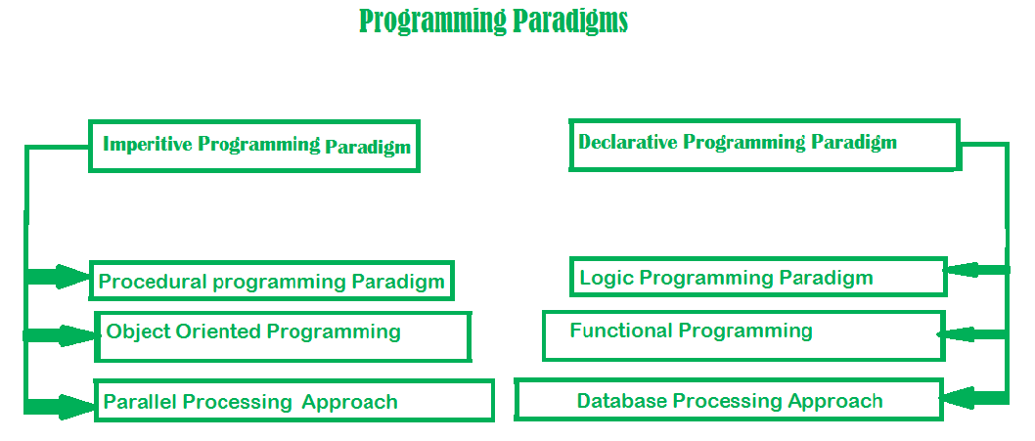

Slide 4
Imperative Programming
Imperative programming consists of sets of detailed instructions that are given to the computer to execute in a given order. It's called "imperative" because as programmers we dictate exactly what the computer has to do, in a very specific way.Imperative programming focuses on describing how a program operates, step by step.Say you want to bake a cake.
1- Pour flour in a bowl
2- Pour a couple eggs in the same bowl
3- Pour some milk in the same bowl
4- Mix the ingredients
5- Pour the mix in a mold
6- Cook for 35 minutes
7- Let chill

Slide 5
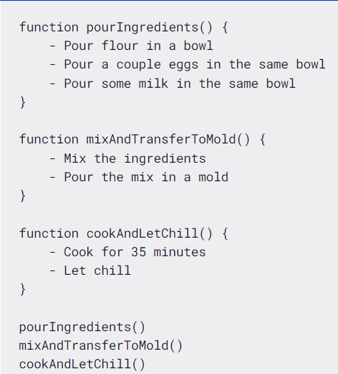
Procedural Programming
Procedural programming is a derivation of imperative programming, adding to it the feature of functions (also known as "procedures" or "subroutines").
In procedural programming, the user is encouraged to subdivide the program execution into functions, as a way of improving modularity and organization.
That simplification and abstraction is one of the benefits of procedural programming. But within the functions, we still got same old imperative code.

Slide 6
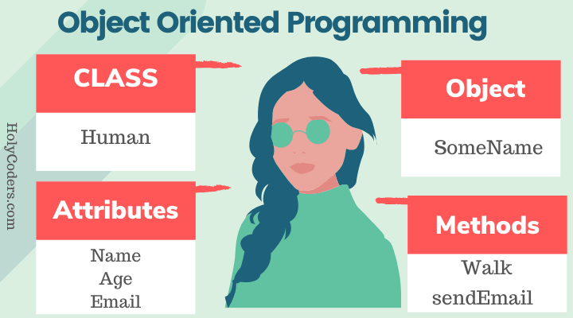
Object oriented programming
The program is written as a collection of classes and object which are meant for communication. The smallest and basic entity is object and all kind of computation is performed on the objects only. More emphasis is on data rather procedure. It can handle almost all kind of real life problems which are today in scenario.
Advantages:
-Data security
-Inheritance
-Code reusability
-Flexible and abstraction is also present

Slide 7
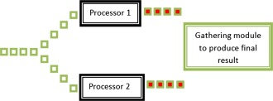
Parallel processing approach
Parallel processing is the processing of program instructions by dividing them among multiple processors. A parallel processing system posses many numbers of processor with the objective of running a program in less time by dividing them. This approach seems to be like divide and conquer.

Slide 8
Declarative Programming
Declarative programming is all about hiding away complexity and bringing programming languages closer to human language and thinking. It's the direct opposite of imperative programming in the sense that the programmer doesn't give instructions about how the computer should execute the task, but rather on what result is needed.It is divided as Logic, Functional, Database. In computer science the declarative programming is a style of building programs that expresses logic of computation without talking about its control flow. It often considers programs as theories of some logic.It may simplify writing parallel programs. The focus is on what needs to be done rather how it should be done basically emphasize on what code is actually doing. It just declares the result we want rather how it has be produced. This is the only difference between imperative (how to do) and declarative (what to do) programming paradigms. Getting into deeper we would see logic, functional and database.

Slide 9
Logic programming paradigms
It can be termed as abstract model of computation. It would solve logical problems like puzzles, series etc. In logic programming we have a knowledge base which we know before and along with the question and knowledge base which is given to machine, it produces result. In normal programming languages, such concept of knowledge base is not available but while using the concept of artificial intelligence, machine learning we have some models like Perception model which is using the same mechanism.
In logical programming the main emphasize is on knowledge base and the problem. The execution of the program is very much like proof of mathematical statement, e.g., Prolog

Slide 10
Functional programming paradigms
Functional programming takes the concept of functions a little bit further.
In functional programming, functions are treated as first-class citizens, meaning that they can be assigned to variables, passed as arguments, and returned from other functions.
Another key concept is the idea of pure functions. A pure function is one that relies only on its inputs to generate its result. And given the same input, it will always produce the same result.
It also defends the idea that code modularity and the absence of side effects makes it easier to identify and separate responsibilities within the codebase. This therefore improves the code maintainability.
Examples of Functional programming paradigm: JavaScript ,Haskell ,Scala ,Erlang and etc.

Slide 11
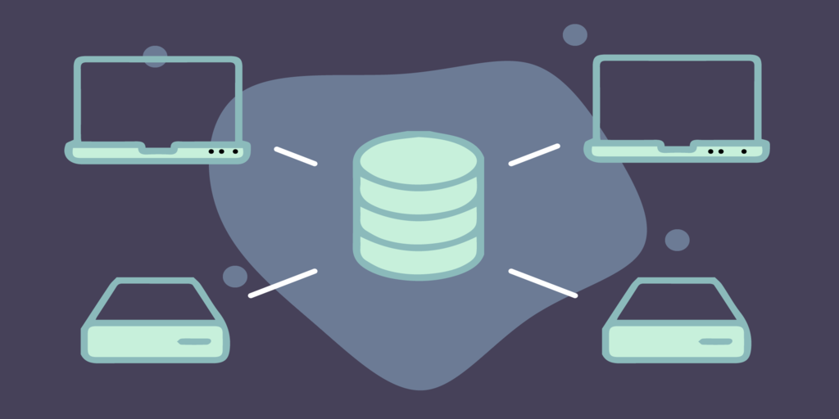
Database programming approach
This programming methodology is based on data and its movement. Program statements are defined by data rather than hard-coding a series of steps. A database program is the heart of a business information system and provides file creation, data entry, update, query and reporting functions. There are several programming languages that are developed mostly for database application. For example SQL. It is applied to streams of structured data, for filtering, transforming, aggregating (such as computing statistics), or calling other programs. So it has its own wide application.

